Slide 1
Rebuttals & Flowing
Columbia YFD - Session 3

Slide 2
What is a Rebuttal?

Slide 3



Rebuttals!
Structure
Extend
Respond
The rebuttal is only a 3 minute speech! Use your time efficiently :)
Remember to extend your own arguments - briefly stating the importance of your arguments!
Respond to your opponent's arguments using evidence and research!
Notes:
Rebuttals come after the constructive speeches - and they are only 3 minutes, so you must use your time effectively! Rebuttals allow for the new introduction of evidence, which you need to use to your advantage in two ways:
1. Part of the Rebuttal is the extend your own arguments. This should not be the main focus of the speech, but it's important to remind the judge of your own arguments. I would do this either at the very beginning of end of the speech (mostly the beginning because it's easy to run out of time at the end of the speech). This can be a short overview/summary of what your position was + impact weighing as to why that's more important than their impacts
2. Respond to your opponent's arguments! Point out logical fallacies in their arguments - but don't worry, we'll go over what that looks like in the next slide!

Slide 4
Responding to the Opponent's Arguments!
Use Research!
Use Common Sense!
Challenge Source Credibility!
Make sure to use your research to provide contradicting evidence that will support your argument!
If you don't have research or just want to supplement your research, you can make logical arguments to respond too!
Finally, make sure to challenge the credibility of the source! Where is the research from? Is the data outdated?
Notes:
Responding can be broken down into 3 main parts:
1. Using Research to break down your opponent's arguments. For example, if the opponent makes the claim that "Random drug testing in schools will deter many students from taking drugs" - an evidence based reputation might be: "A study published in 2003 by researchers at the University of Michigan tracked 94,000 middle- and high-school students, and found that “even if drug testing is done randomly and without suspicion, it's not associated with a change in the number of students who use drugs in any category.” Grim, Ryan. “Blowing Smoke: Why random drug testing doesn't reduce student drug use”. Slate. March 21, 2006.
It's important to always reference the source of the information for verification purposes!
2. Logic-based refutation - if you don't have research or just want to supplement your research, you can respond with logical arguments too. These are things that 1) you can bring up if you have some part of your arguments that already respond to this or 2) it just makes logical sense that something is that way. For example, a logical response to the example above is that "the intense drug culture in high
school means kids would rather find creative ways of passing drug tests than actually quitting the use of drugs".
3. Finally, the last type of "refutation" is calling into question the source of where the information is coming from. Plenty of people have been debunked and studies have been disproven - so make sure to call that out when you are researching information. Or if their studies are too old, make sure you reference that too because things change!

Slide 5
Using Weighing in the Rebuttal
What is Weighing?
Last class we learned that weighing is a way of comparing impacts - i.e. showing that your args matter more!
Convince the Judge
Weighing in the rebuttals requires you to compare your impacts to their impacts (and see who's more)!
PMTR
Choose a point (probability, magnitude, time-frame, reversibility) to focus on that makes your impact unique!
Notes:
This brings us to weighing in a rebuttal. Last class, we learned that weighing is a way to compare impacts - i.e. showing that your arguments matter more than your opponent's. Since we went over this last class, I won't go into depth - but I wanted to mention its unique application to weighing in the rebuttal speeches!
1. Convince the judge - DEBATE is a game of convincing, and your job is to do that. That means at (pretty much) every point in the speech - you should be doing some form of weighing. It doesn't have to be explicit - but you want to plant a seed in the back of the judges mind that they're constantly pitting your arguments (and framing how they should evaluate it) against your opponent's. Essentially, you want to control how the judge weighs competing arguments - whether that be through "better evidence," more refutation, or just pure convincing!
2. Sadly, debate is a timed activity - which means you can't pick every single thing and weigh it against every single thing. So it requires careful selection. Pick your strongest arguments and strongest "weighing" arguments and make those really clear to any judge. Usually, this means picking one of the PMTR (prob, mag, time frame, reversibility) and honing in on why that makes your argument more important evaluate than your opponent's.

Slide 6
How does the judge evaluate arguments?

Slide 7

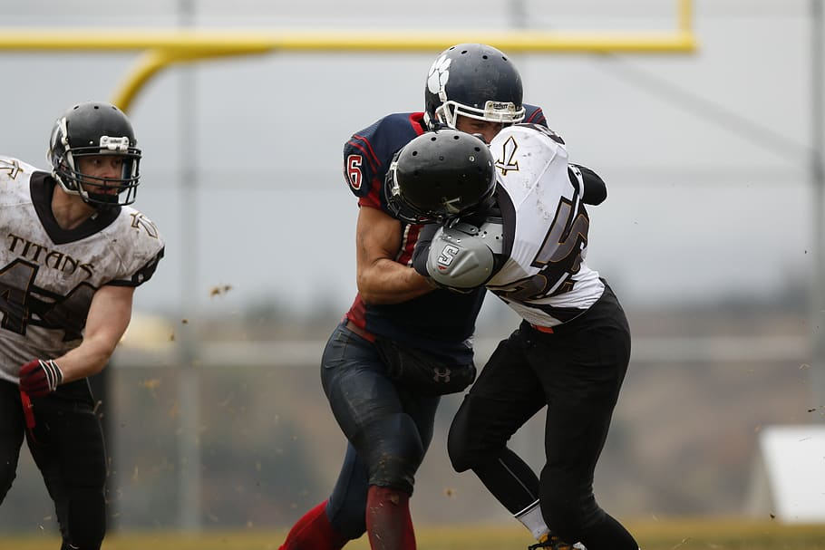
Offense vs. Defense!
Offense
Defense
Offense is any reason why the judge should vote for your side! Broadly, these are considered to be "your own arguments."
Defense is any reason why the judge should NOT vote for your side. Broadly, these are considered to be "responses to opponents arguments"
Notes:
Another important thing to mention are the terms offense and defense (since we will be using these throughout the lesson and from now on). Although they're pretty self-explanatory - let's explain!
Offense is, at its very core, your own arguments. These are reasons why the judge should vote for your side. On the other hand, defense is reasons why the judge should not vote for the other side. Every debater must use these carefully and in accordance with one-another. Sadly, "defense does not win games". You must have a good amount of both! Not only must you tell the judge why you should win - your offense, but you must also tell the judge why the other team should not win - your defense. These two make up a lot of impact/argument weighing so it's improtant to understand them.
There is no secret formula to the balance between offense and defense, and it's usually debate-speicifc. Just know that you should have both, and the team that does a better job cultivating the relationship between their offense and defense usually wins :)

Slide 8


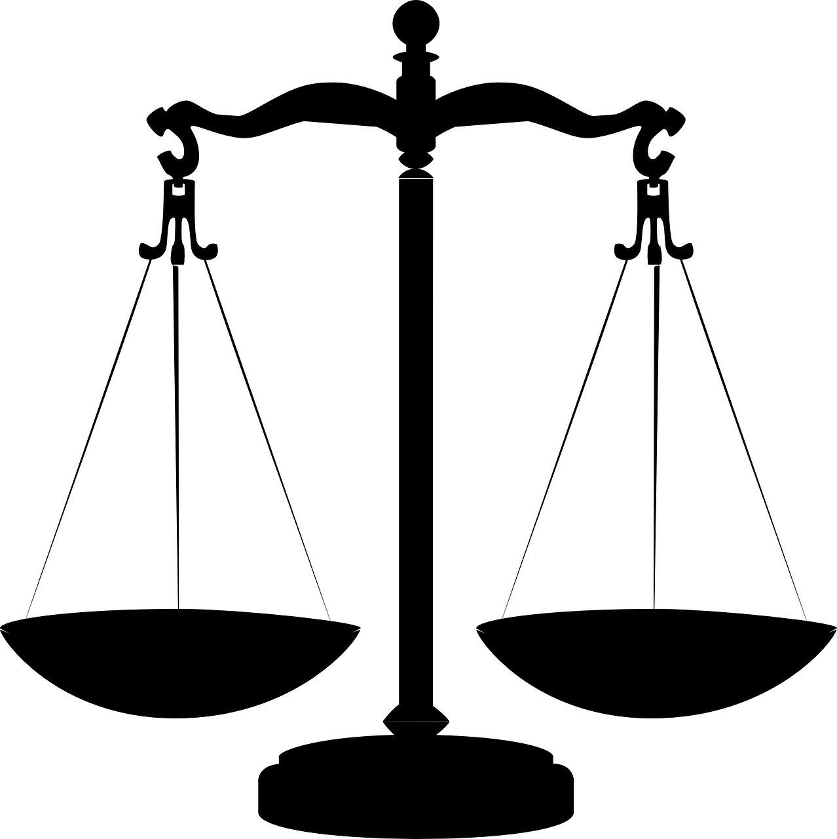
Rebuttals
Reiterate Your Own Offense!
Respond with Defense!
Weigh Args and Impacts!
Notes:
1. So to put everything together, rebuttals require you to reiterate your own offense - "tell the judge why you should win"
2. Respond to your opponent's offense - "tell the judge why they shouldn't win via defensive arguments"
3. Weigh arguments and impacts - "compare your offense and defense versus theirs and tell the judge why yours are more important"

Slide 9


We already know that offense and defense are important? But how do we know what arguments to respond to?
The Flash

Slide 10
Taking Notes "Flowing"
Notes:
In order to respond to arguments, you have to have some way of keeping track of your opponent's arguments - this is the process of what we call "flowing".
Top level:
Flowing consists of writing down (shorthand) your opponent's arguments and then writing your responses down to each specific argument. Taking notes or "flowing" helps keep some organizational structure to the debate/the way that arguments develop.
Each speech is given a "column" and arguments are separated by spacing them down the column. As the speeches develop, you line up the arguments with the ones being answered! An example will be shown in 2 slides.

Slide 11
The Basics of Flowing
01.
03.
Simplify Complex Args
Separate AFF vs NEG
There are a lot of arguments in debate! It can be hard to write down long detailed descriptions, so simplify!
Your arguments should go on a separate page than their arguments! It helps with organization :)
02.
04.
Separate Different Args
Use Shorthand
Each distinct argument should be separated on the page - this way, you will know what to respond to!
- Impact = "!"
- Shorten words that are really long
- Develop one that you can read!
Notes:
Some tips and tricks for flowing:
1. Arguments can be complex and annoying to write in their entirety - so simplify it! Write shorthand - people speak quickly and it's important that you don't miss anything - so make sure to write legibly as well as simplified, so it takes less time for you to write what their saying compared to how fast they're saying it.
2. Separate different arguments. I mentioned this before, but things will get jumbled up if you don't separate your arguments. Make sure to do that down each column.
3. Separate offense and defense into DIFFERENT FLOW SHEETS. Above, we mentioned separating arguments by spacing along the same flow sheet - but this requires you to have a completely different flow sheet.
4. Use shorthand. I use impact being an exclamation mark and other things can be simplified to other things as well. Use shorthand cus you can write so much faster - which helps with not missing things. Also, if you're handwriting is bad, universal symbols can help your partner interpret if they missed something on their flow.

Slide 12

Other Important Tips!
The Judge is Flowing Too!
Give a Roadmap :)
Talk Clearly, And Be Organized
This is how the judge will ultimately evaluate the end of the debate (by looking at their flow sheets)!
Tell the Judge at the beginning of each speech how to organize their flow sheets. And be clear when transitioning between sheets!
The judge needs to be able to write down what you are saying! So speak clearly, and differentiate arguments.
Notes:
Other important tips!
The judge uses the flow @ the end of the debate to evaluate the arguments that were developed/made important during the round. This means that you should.
TALK AND BE ORGANIZED
when you are speaking, make sure that the judge is able to actually write down what you are saying AND can follow when you are answering multiple arguments. As you jump from argument to argument, do what debaters call "signposting" and let the judge know. this can be as simple as "to answer <x> argument," just so the judge can keep their flow organized. A more organized flow always benefits you since they can clearly see that you made the effort to answer every argument - which makes your offense/defense combo a little more clear.
This also is along similar lines to giving what we call a "roadmap". In every debate, since there is at least 1 piece of offense per team, you should have more than 1 sheet of "flow paper". This means that the judge will also have more than 1 sheet of paper when keeping track of these arguments. So before the speech start, let them know the order of how you will be speaking - i.e. which things you will address first. This helps with their flowing since they are able to order their sheets before the speech starts - which helps keep their flowing more organized and less chaotic.

Slide 13

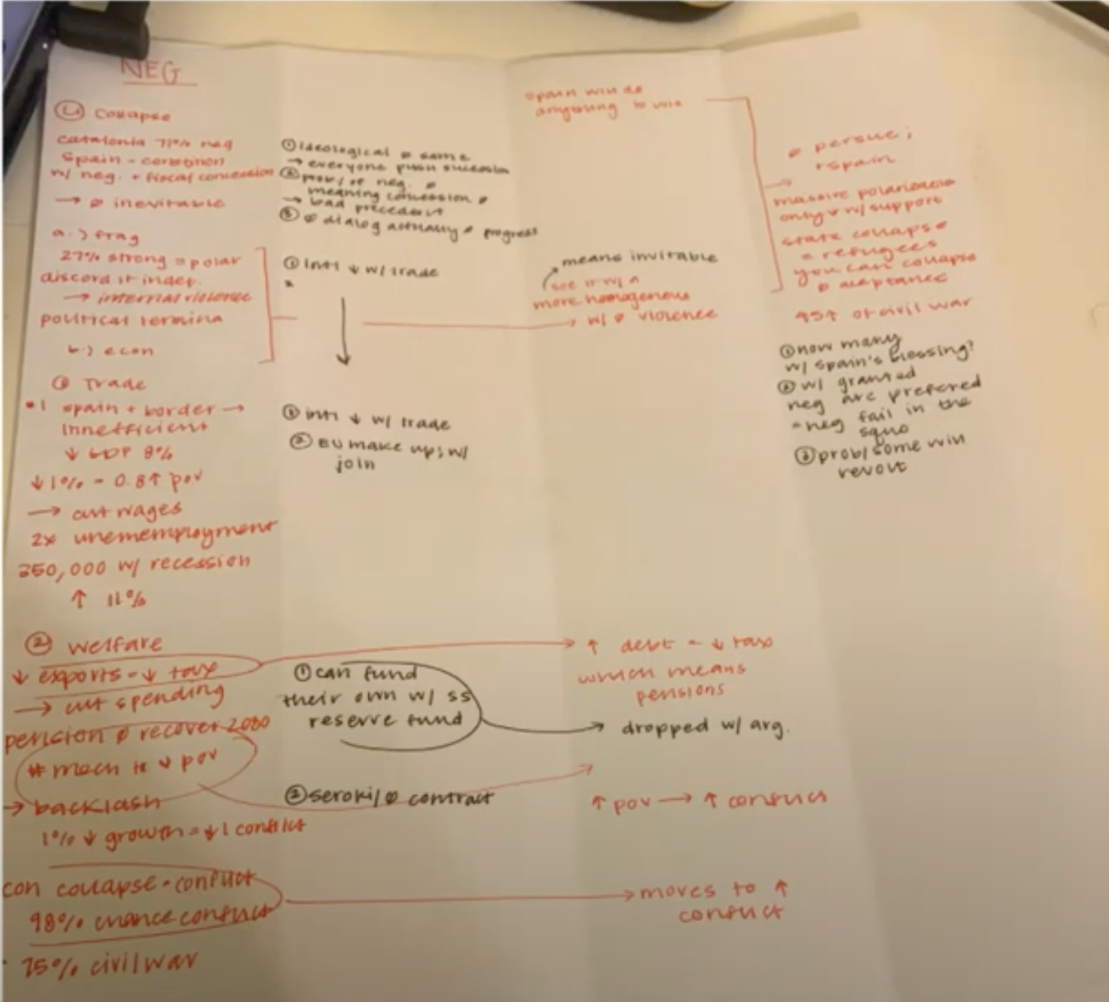
Example of a Flow in a Debate
Notice the two different colors
Each speech flows downward - clearly a "lineup" of arguments
They write responses down on the flow!

Slide 14
Spar Debates (Again)!
Notes:
Finally, let's do SPAR debates! Practicing what we learned for today.

Slide 15
Tips & Tricks for SPAR Debates!
SPAR Format:
- AFF/NEG Constructive (2 minutes)
- AFF/NEG Rebuttal (2 minutes)
Employ What we Learned:
- Impact Weighing
- Rebuttals
- Flowing
Crossfire + Prep Time
- 2 minutes each!
- Use it wisely
Topics:
- Superheroes are misleading idols
- Money can't buy happiness
Notes:
- Here are the rules listed on the left column
- MAKE SURE TO EMPLOY THE TOPICS WE LEARNED
- Topics can be pulled from last slide or use the ones I've included here.
HERE ARE MORE TOPICS: http://vipspeech.yolasite.com/resources/SPAR%20Topics%20(Week%20One).pdf

Slide 16
Thanks !

